Slide 1
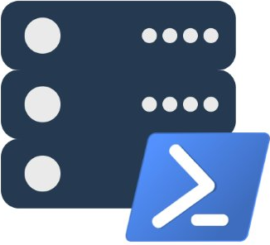
Modern Database Administration with PowerShell and dbatools
Presented by @cl and @mobileck
dbatools.io | dbatools.io/slack | dbatools.io/youtube | sqlps.io

Slide 2
About
Chrissy LeMaire - @cl
DBA with General Dynamics IT at NATO Spec Ops HQ
PowerShell MVP
Creator of dbatools.io
Constantine Kokkinos - @mobileck
SQL Server DBA at Avionte Software
Apple Certified Trainer
dbatools Major Contributor & git merger extraordinaire
dbatools.io | dbatools.io/slack | dbatools.io/youtube | sqlps.io

Slide 3
OHH! We’re doing a Summit pre-con!
October 31, Seattle WA
Around 8 hours of awesome!
Lab included
dbatools.io | dbatools.io/slack | dbatools.io/youtube | sqlps.io

Slide 4

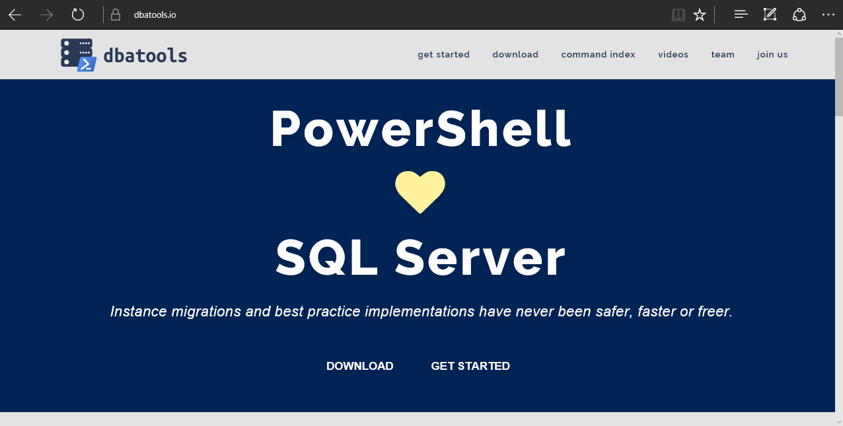
dbatools
dbatools.io | dbatools.io/slack | dbatools.io/youtube | sqlps.io
Notes:
Community project, initially started out as Start-SqlMigration but has grown into a DBA’s best friend. dbatools currently sports 100 commands.
How many of you have heard of dbatools? How many of you have used it?

Slide 5
System Requirements
Minimum
Client
PowerShell v3
SSMS / SMO 2008 R2
Server
SQL Server 2000
No PowerShell for pure SQL commands
PowerShell v2 for Windows commands
Remote PowerShell enabled for Windows commands
Recommended
Client
PowerShell v5.1
SSMS / SMO 2016
Server
SQL Server 2008R2+
dbatools.io | dbatools.io/slack | dbatools.io/youtube | sqlps.io
Notes:
Started as a migration tool, so I strived to support older environments
No reliance on SQLPS, because we’ve got a history ;)

Slide 6
Install is easy
PowerShell Gallery
Install-Module dbatools
Install-Module dbatools –Scope CurrentUser
GitHub – dbatools.io/git
Invoke-Expression (Invoke-WebRequest dbatools.io/in)
dbatools.io | dbatools.io/slack | dbatools.io/youtube | sqlps.io
Notes:
Gallery requires admin access and is built into PowerShell v5. Other versions also support it with a bit of configuration.
Download
Unzip
Import-Module

Slide 7
Visit the website
dbatools.io | dbatools.io/slack | dbatools.io/youtube | sqlps.io
Notes:
Community project, initially started out as Start-SqlMigration but has grown into a DBA’s best friend. dbatools currently sports 100 commands.
How many of you have heard of dbatools? How many of you have used it?

Slide 8
demo
dbatools.io | dbatools.io/slack | dbatools.io/youtube | sqlps.io

Slide 9

Community got us feelin’ like
dbatools.io | dbatools.io/slack | dbatools.io/youtube | sqlps.io
Notes:
Cut it out.

Slide 10
Review
PowerShell is a data pro’s best friend Migrations Best Practices Reporting
Join us! dbatools.io/slack #dbatools
dbatools.io/youtube
dbatools.io | dbatools.io/slack | dbatools.io/youtube | sqlps.io

Slide 11
How to Get-Help
Extensive documentation within each command Get-Help Start-DbaMigration –Detailed
Extensive documentation on dbatools.io
dbatools.io/Start-DbaMigration
dbatools.io/Repair-DbaOrphanUser
Some commands have videos
dbatools.io/youtube
dbatools.io | dbatools.io/slack | dbatools.io/youtube | sqlps.io

